Slide 1
Birdstrikes on aircrafts

Slide 2
Introduction
A bird strike is strictly defined as a collision between a bird and an aircraft which is inflight or on a take-off or landing roll. The term is often expanded to cover other wildlife strikes - with bats or ground animals.
Bird Strike is common and can be a significant threat to aircraft safety. For smaller aircraft, significant damage may be caused to the aircraft structure and all aircraft, especially jet-engine ones, are vulnerable to the loss of thrust which can follow the ingestion of birds into engine air intakes. This has resulted in several fatal accidents.
Bird strikes may occur during any phase of flight, but are most likely during the take-off, initial climb, approach and landing phases due to the greater numbers of birds in flight at lower levels.

Slide 3
Details OF data
Record ID
Aircraft: Type
Airport: Name
Altitude bin
Aircraft: Make/Model
Wildlife: Number struck
Wildlife: Number Struck Actual
Effect: Impact to flight
FlightDate
Effect: Indicated Damage
Aircraft: Number of engines?
Aircraft: Airline/Operator
Origin State
When: Phase of flight
Conditions: Precipitation
Remains of wildlife collected?
Remains of wildlife sent to Smithsonian
Remarks
Wildlife: Size
Conditions: Sky
Wildlife: Species
Pilot warned of birds or wildlife?
Cost: Total $
Feet above ground
Number of people injured
Is Aircraft Large?

Slide 4
Main KPI’S
Total BirdStrikes – Count of all birdstrikes occur during 2000-2011
Total Cost Incurred – Sum of the cost incurred
Total People Injured – Sum of peoples Injurrred
Avg. Height of Strike – Average Height on which strikes occurs

Slide 5
Insights
Most Nos of BirdStrikes occured in the year 2011.
While Approaching the Birdstrikes occur in highest Nos than other,
Dallas Fort Worth International Airport had most Nos of Birdstriikes while landing.
Business Airlines got most Nos of Birdstrikes.
Birdstrikes occurred mostly at height less than 1000 feet.
Mostly the pilots weren’t warned about the strike.
Due to the birdstrikes many planes had precautionary landing.

Slide 6
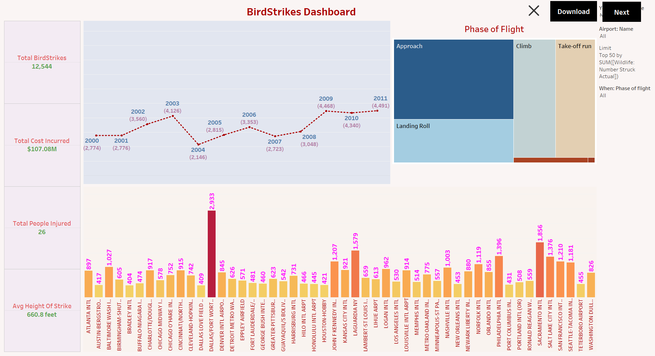
Mock – up dashboard

Slide 7
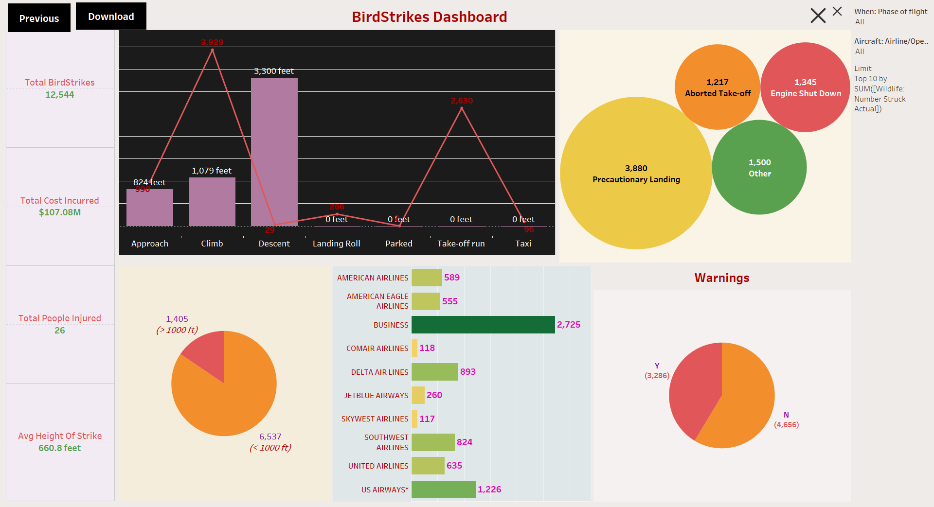
My Designs

Slide 8


